Slide 1
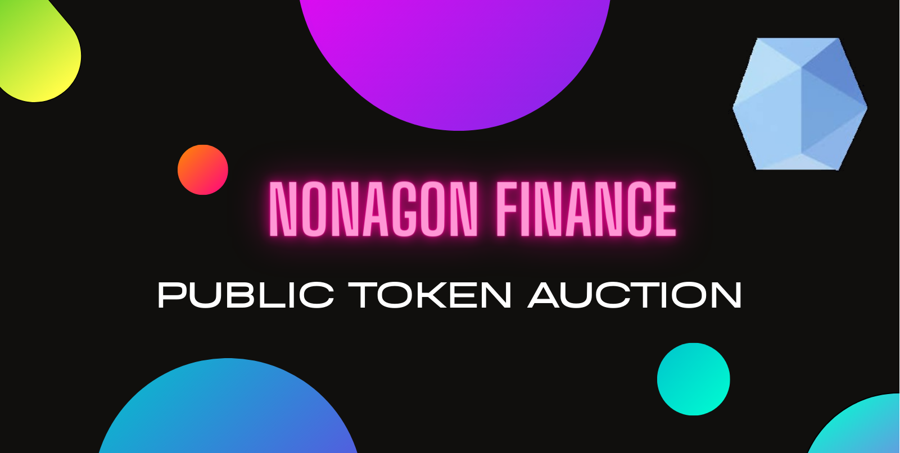

Slide 2
Introduction
Overview
Protocol fees
Architecture
Sources

Slide 3

Introduction
Nonagon Finance is a free, decentralized
perpetual and derivative leverage trading protocol
built on
Ethereum’s L2 Optimism

Slide 4
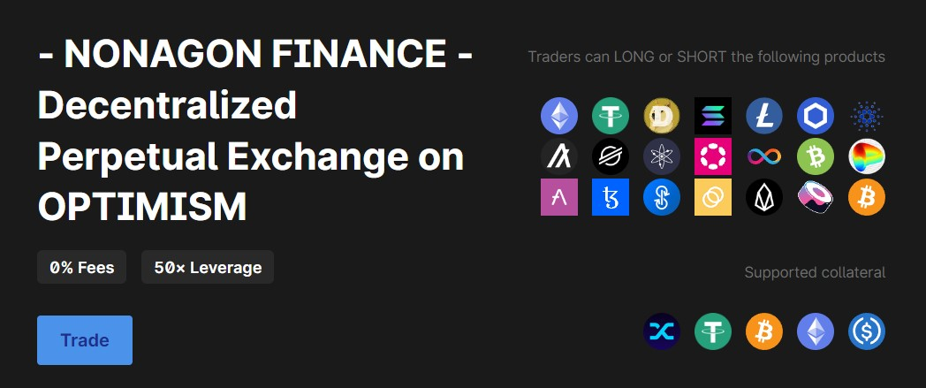
Introduction

Slide 5
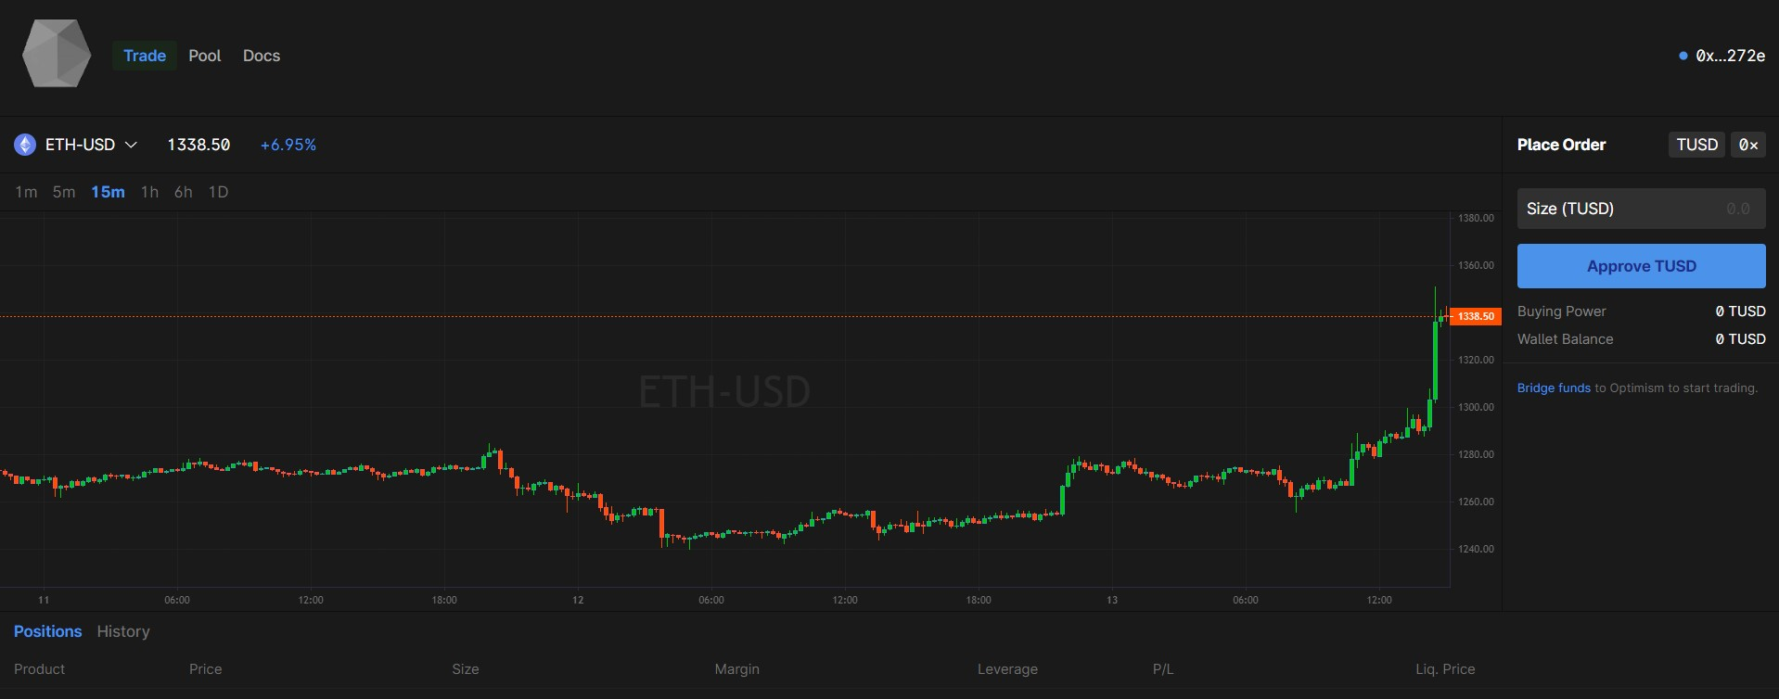
Introduction

Slide 6
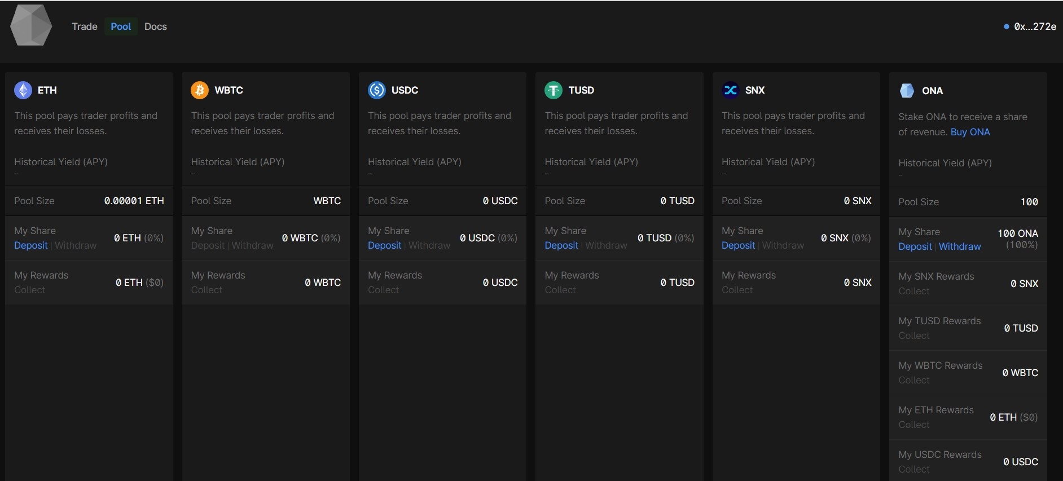
Introduction

Slide 7
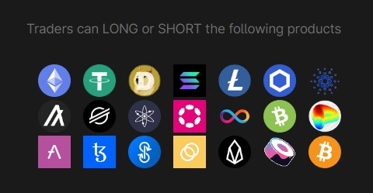
Introduction

Slide 8
Overview
How users can interact with Nonagon Finance:
Trade directly from your wallet, no account needed. Optionally select leverage up to 50x to multiply potential profits / losses.
Trades are free with 0% fees.
Traders can LONG or SHORT 21 different markets.
Pool ETH, USDC, TUSD, WBTC and SNX to back trader profits and receive a share of trader losses.

Slide 9
Protocol revenues
Since traders do not pay any trading fees, how do stakers in the pools and ONA token holders profit?
COLLATERAL POOL STAKER PROFIT:
When a trader for example goes short on the price of Polkadot, but the market moves in the other direction, then the loss of the trader becomes the profit for the staker of pool. See “Outcome 2”.
Rewards in case of liquidation (see “Outcome 3” on next slides for detailed description).
ONA TOKEN HOLDERS PROFIT:
Withdrawal fees from staking pools are distributed among ONA token holders who stake their ONA tokens in the ONA pool.
Rewards in case of liquidation (see “Outcome 3” on next slides for detailed description).

Slide 10
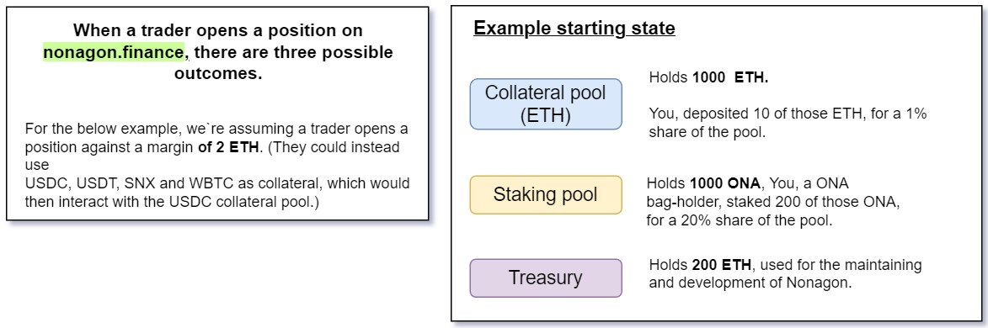
Protocol revenues

Slide 11
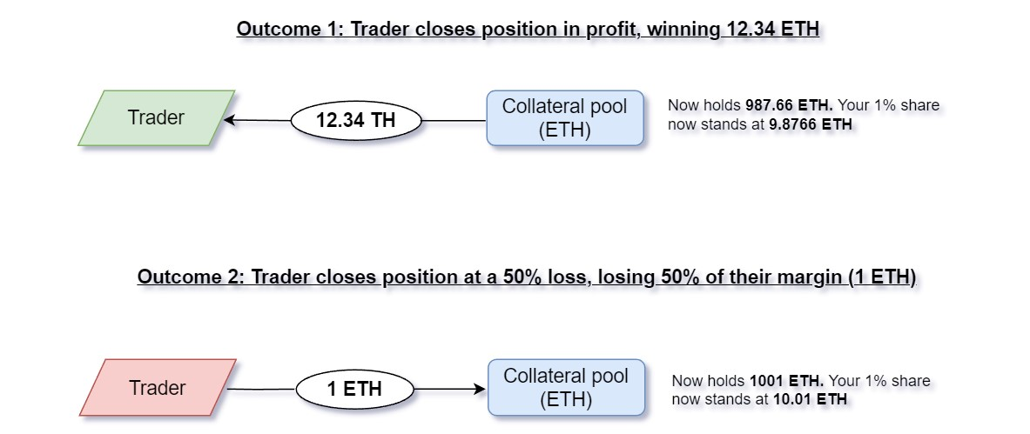
Protocol revenues

Slide 12
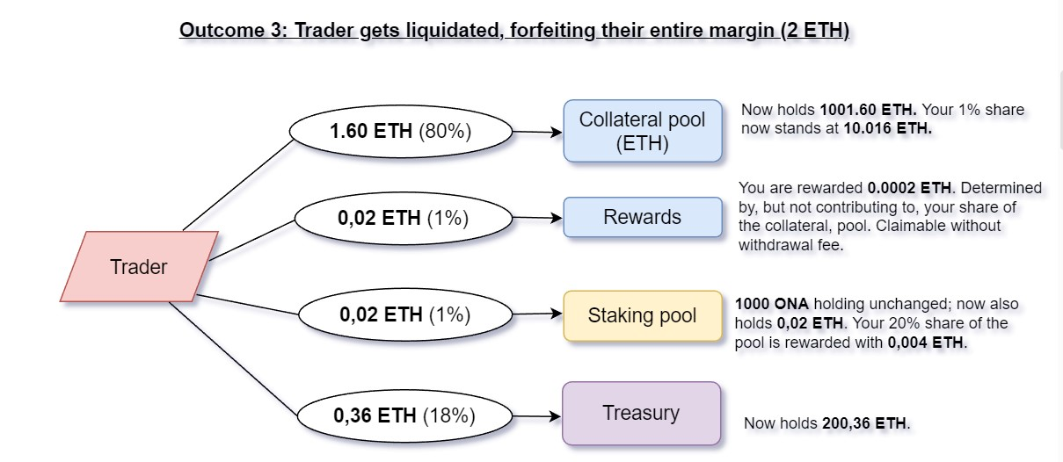
Protocol revenues

Slide 13
Protocol revenues
Why are no protocol revenues generated and why are there literally no traders and investors yet? How will the raised funds from the Gnosis Auction be used?
Since its inception in Q3 2022 Nonagon Finance focused on the technical implementation alone and didn’t conduct marketing campaigns as well as did not raise any capital.
Marketing campaigns for DeFi projects are not free and raising funds for the financing of those is one of the token auction goals, whereas it is planned to distribute up to 20% of the total funds raised in efforts to raise awareness about Nonagon among traders and stakers.
The pools are empty since no stakers can be attracted if their balance is zero. Therefore 70% of the funds raised through the sale of ONA tokens will go to the staking pools as well as the ONA – ETH pool on Uniswap which at the moment has a miniscule liquidity of approx. 1.000 USD.

Slide 14
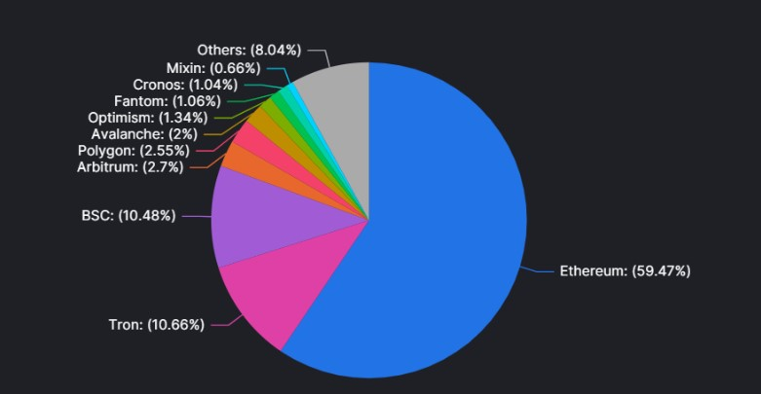
Protocol development
Up to 20% of total funds raised or a minimum of 200000USD will be used for further protocol development, such as the deployment of Nonagon to Ethereum, BSC, Tron and Avalanche.
The deployment will be prioritized according to the TVL of the respective chains.
The graphic below shows the Total Value Locked TVL in all EVM compatible chains

Slide 15
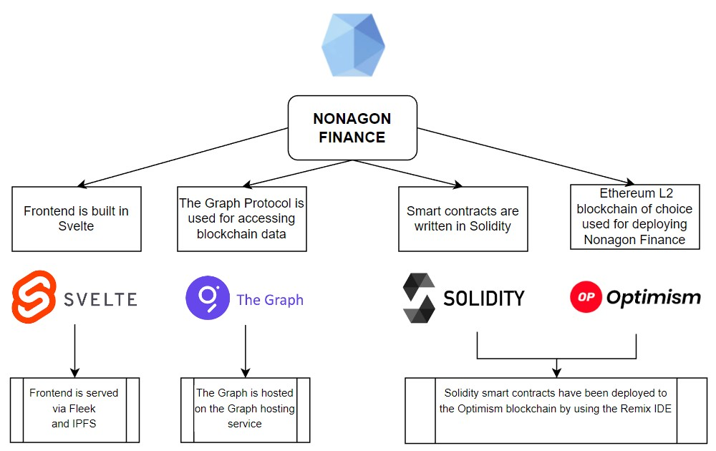
Architecture – components and deployment

Slide 16
Smart contracts
Trade execution:
Trading 0x699ec8F15802A17B74821894088E8733b5a59C63
Router 0xAEbcB1D4655bDb0D753AAD238beb32000c4B91AC
Treasury 0x885C00125AaF2bf16d4A527b33BFEE20Ae5E121c
Oracle 0x8F2D8BA71B65d3F341E173d8a2AC049CA397e497
Pools:
PoolONA 0x58Bd1102f3dABDf95F2D5D2147F4d96Ef66973B8
ONArewardsUSD C0x4b516Cd2a47AF1B1641f06E92fdfdad6CBB07c52
There is a ONArewards pool for every staking pool separately, which are used for collecting protocol based revenues such as withdrawal fees.
Pool Rewards USDC 0xcE8eF8e0f0FE68c618A7a9A8ab6871511f41B403
→ There is a rewards pool for every staking pool separately for receiving profits.

Slide 17
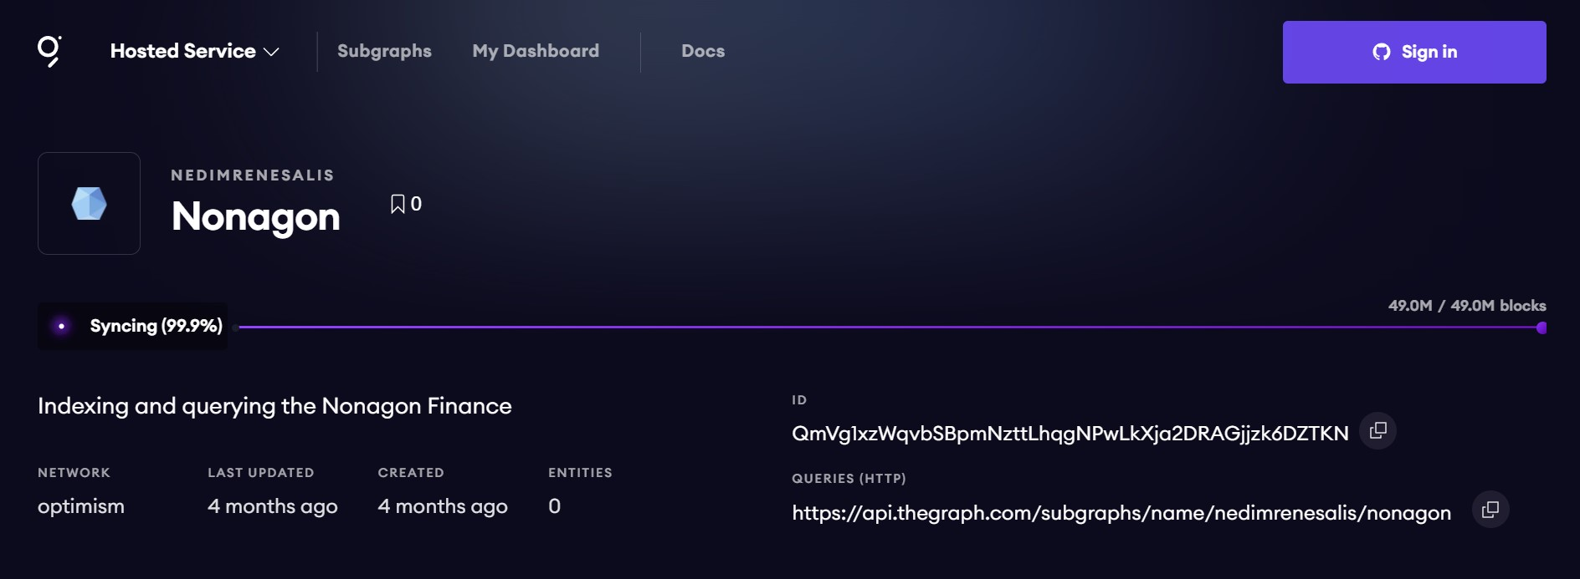
The Graph

Slide 18
Sources
https://nonagon.finance/
https://github.com/Nonagon-Finance
https://thegraph.com/hosted-service/subgraph/nedimrenesalis/nonagon?selected=playground
https://nonagon-finance.gitbook.io/introduction/
https://www.optimism.io/
https://defillama.com/chains

Slide 19
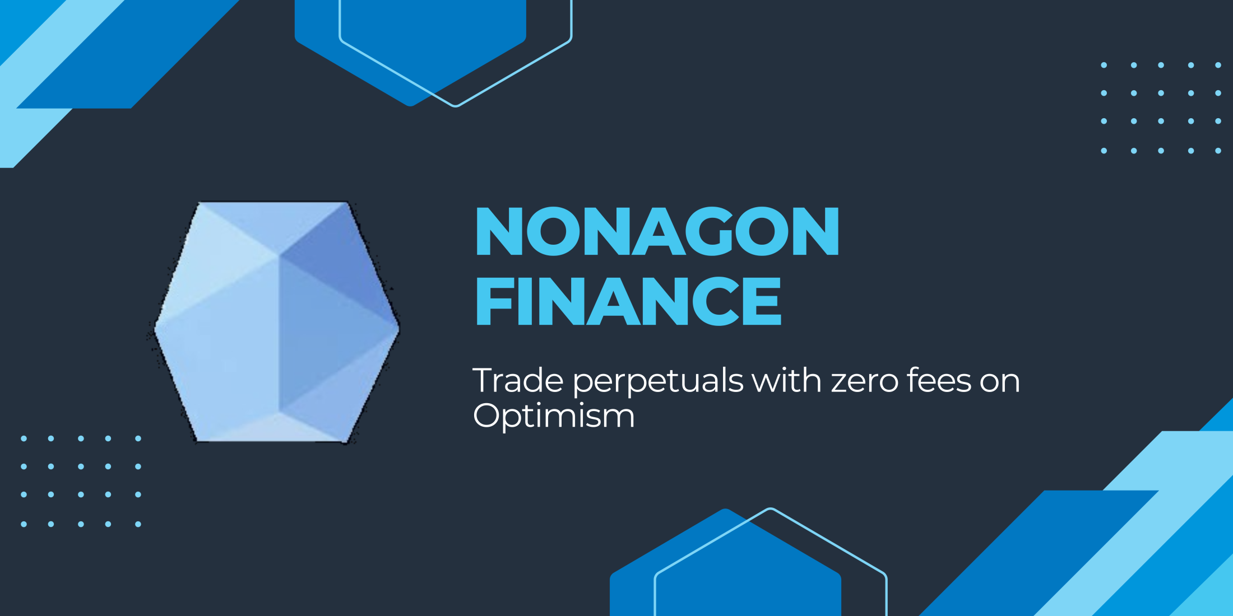

Slide 20


